Slide 1

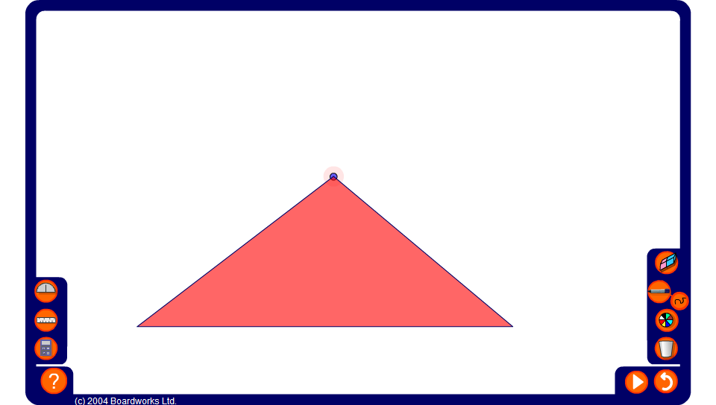


Angles in a triangle
Notes:
Change the triangle by moving the vertex. Pressing the play button will divide the triangle into three pieces. Pressing play again will rearrange the pieces so that the three vertices come together to form a straight line. Conclude that the angles in a triangle always add up to 180º.
Pupil can replicate this result by taking a triangle cut out of a piece of paper, tearing off each of the corners and rearranging them to make a straight line.

